Slide 1

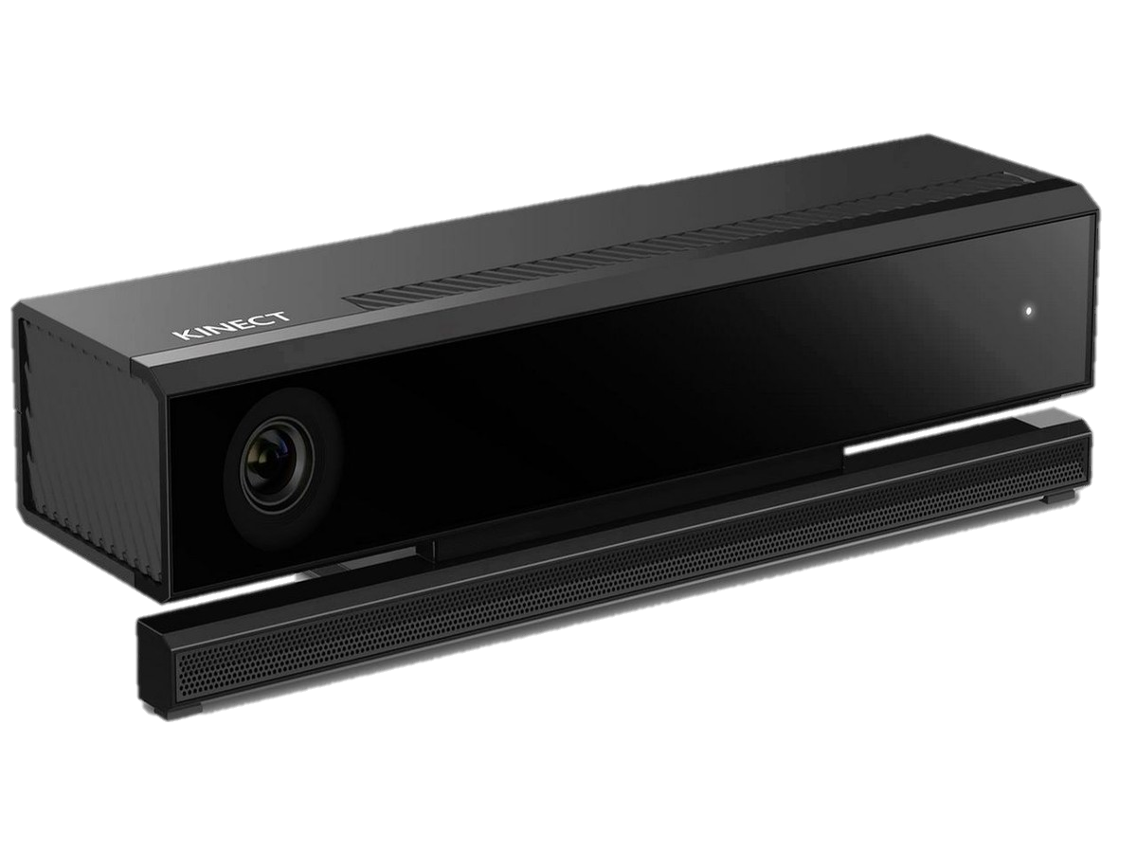
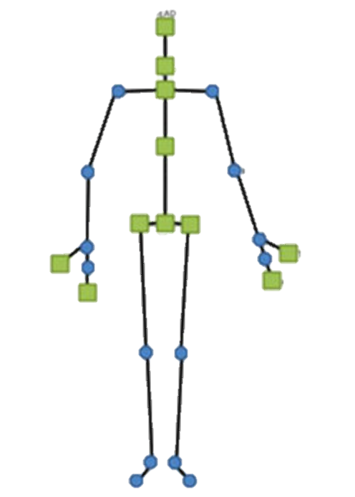
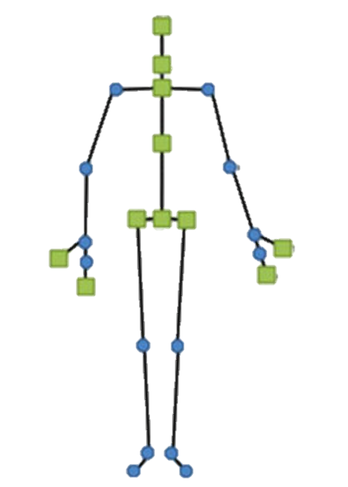

Kinect Block Diagram
Obtain joint of interest
Capture Local Timestamp
Send to Signal Correction Unit
3D position
Posture estimation
Compute Sagittal and Flex angle
Completed
Requires Refinement
Vicon
Send to Display Feedback
Not yet Implemented

Slide 2

Render Initial View
Standby
Tracked Body?
No
Display Feedback Flowchart
Yes
Visual Gesture Builder
Compute Sagittal & Flex Angle
Gesture Database
Kinect Studio
Recorded Clips
Error?
No
Update Message
Parse Error Code
Completed
Requires Refinement
Update Error Message
Go back to standby
Not yet Implemented

